Slide 1
IBM HR Analytics Employee Attrition & Performance

Slide 2
Problem Statement
Company Wants To Know Why Employees Are Leaving The Company
Attrition: It is basically the turnover rate of employees inside an organization. In the realm of human resources, attrition is defined as both the voluntary and involuntary reduction of a company’s workforce through deaths, employee retirements, transfers, resignations and terminations. This can happen for many reasons:
Employees looking for better opportunities.
A negative working environment.
Bad management
Sickness of an employee (or even death)
Excessive working hours

Slide 3
About The Data
The dataset contains 1470 observations and 35 variables.
There are no missing values.
Variables type:
Numeric variables
Categorical variables

Slide 4
Exploratory Data Analysis

Slide 5
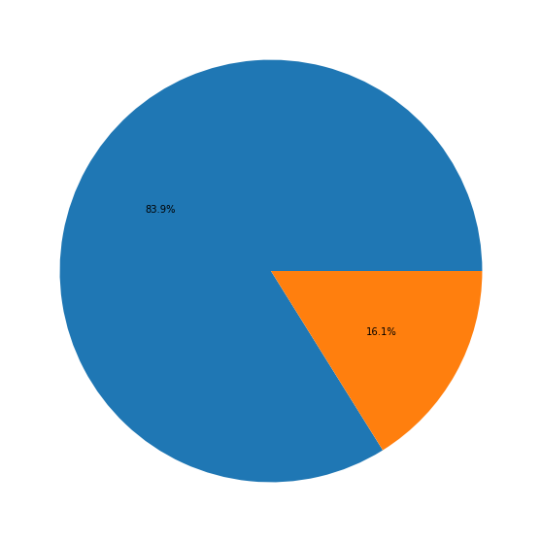
Attrition Rate
Looks like about 84% of employees stayed and 16% of employees left
That is 237 out of 1470 employees churned

Slide 6
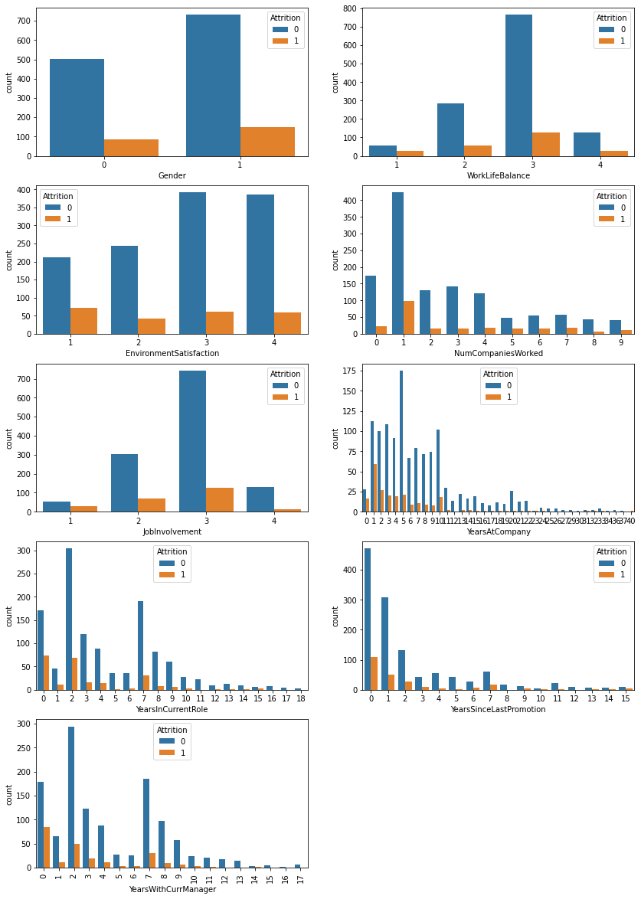
Observations:-
1 Men tends to leave company sooner than women
2 Who have least worklife balance tends to resign faster than other
3 Who leastly likes the environment in company tends to leave company sooner than others
4 Who worked for more number of compannies tends to switch again!
5 Who leastly involves in Job in company tends to leave company sooner than others
6 Seniors in company tends to leave sooner than others, Employee leaving the company at initial stage
7 Who stays in current role for longer time and who just got new role tends to leave company sooner than others
8 Who don't get promotion for long time tends to leave company
9 Who stays with Manager for longer time and shorter time tends to leave company than others

Slide 7
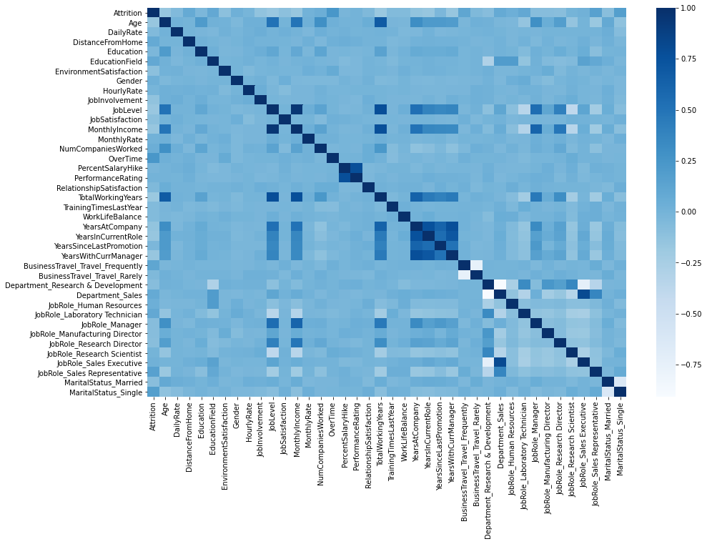
Observations:-
Joblevel is highly corelated with MonthlyIncome (95%)
JobLevel is correlated with TotalExperience (78%)
Percentage of SalaryHike is related to PerformanceRating (77%)
MonthlyIncome is correlated with TotalExperience (77%)
YearsAtCompany is correlated with YearswithCurrentManager (77%)
YearsAtCompany is correlated with YearCurrentRole (76%)
Attrition rate is comparatevely highly correlated with OverTime (25%)

Slide 8
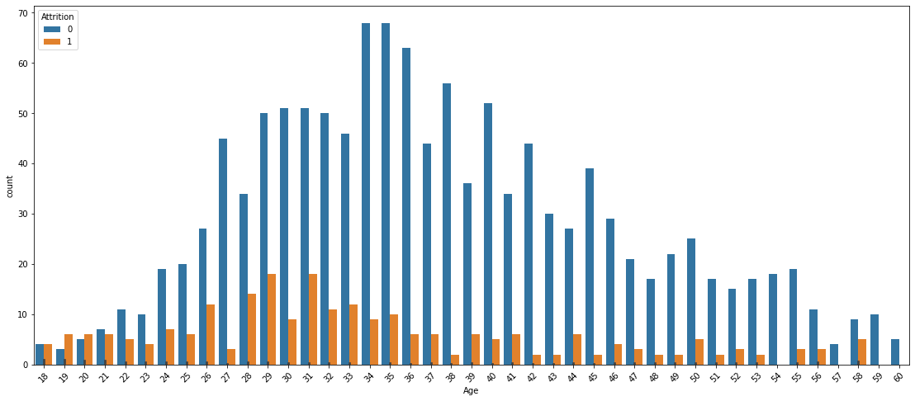
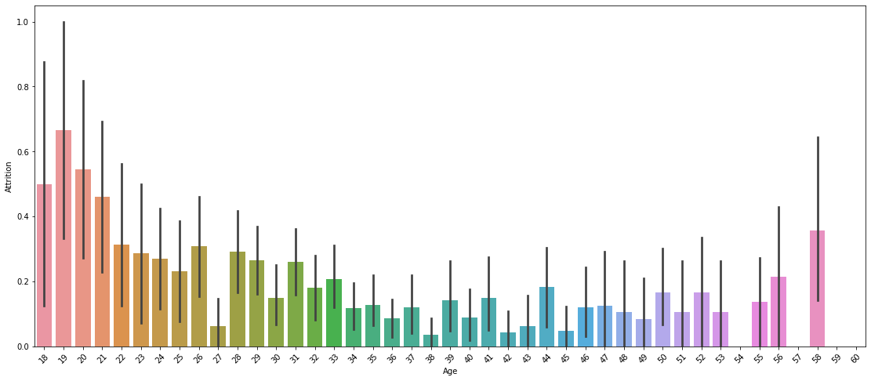
Age vs Attrition
Observations:
Age is distributed quite normally and Employee who churn are younger.
Teenagers highly tends to leave company than Mid aged
Persons whose age more than 55 tends to leave company than Mid aged

Slide 9
Data Preprocessing

Slide 10
Converting Catagorical Features
I used get_dummies() function, which is used to convert categorical variable into dummy/indicator variables.
Replaceing Catagorical columns in a data frame

Slide 11
Model Building

Slide 12
Supervised Machine Learning
1. Logistic Regression
Accuracy with Logistic Regression: 83.67
2. Decision Tree Classification
Accuracy with DecisionTreeClassifier : 76.33
3. Random Forest Classification
Accuracy with Random Forest Classifier : 83.67

Slide 13
Ensemble Learning
1. Ada Boost Classifier
Accuracy Score with Ada Boos tClassifier : 85.5
2. Gradient Boosting Classifier
Accuracy Score with Gradient Boosting Classifier : 83.27
3. XG Boost Classifier
Accuracy Score with XG Boost Classifier : 84.49

Slide 14
Conclusion
Ada Boost Classifier performed well on this problem

